Slide 1
Introduction to NLP

Slide 2
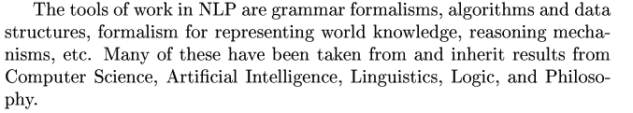
Goal of NLP
Build computational model of NL for analysis and generation
Build machine translation system
Build Hand written pattern recognition

Slide 3
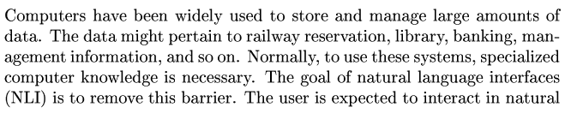
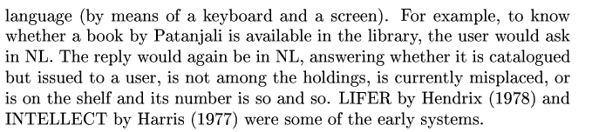
Natural Language interface to Database

Slide 4
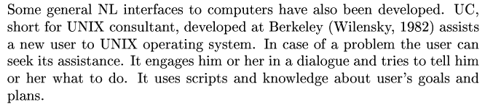
Natural Language interface to Computers

Slide 5
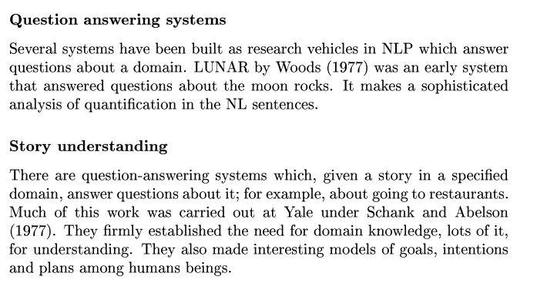

Slide 6
Major Goal
1. Development of grammar rich language by including well formed rules.
2. computational requirement
3. System must deal with erroneous inputs.
4. to understand the difference between conventional linguistic system and computational linguistic system
5.Cognitive science

